Slide 1
VECTORS

Slide 2
A vector is a quantity that has both magnitude and direction. It is represented by an arrow. The length of the vector represents the magnitude and the arrow indicates the direction of the vector.
Blue and orange vectors have same magnitude but different direction.
Blue and purple vectors have same magnitude and direction so they are equal.
Blue and green vectors have same direction but different magnitude.
Two vectors are equal if they have the same direction and magnitude (length).

Slide 3
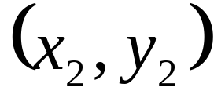
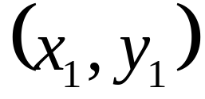
How can we find the magnitude if we have the initial point and the terminal point?
Q
The distance formula
Terminal Point
magnitude is the length
direction is
this angle
Initial Point
P
How can we find the direction? (Is this all looking familiar for each application? You can make a right triangle and use trig to get the angle!)

Slide 4
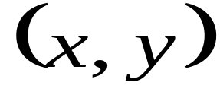
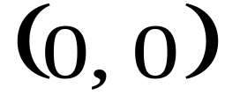
Although it is possible to do this for any initial and terminal points, since vectors are equal as long as the direction and magnitude are the same, it is easiest to find a vector with initial point at the origin and terminal point (x, y).
Q
Terminal Point
A vector whose initial point is the origin is called a position vector
direction is
this angle
Initial Point
P
If we subtract the initial point from the terminal point, we will have an equivalent vector with initial point at the origin.

Slide 5


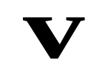
To add vectors, we put the initial point of the second vector on the terminal point of the first vector. The resultant vector has an initial point at the initial point of the first vector and a terminal point at the terminal point of the second vector (see below--better shown than put in words).
To add vectors, we put the initial point of the second vector on the terminal point of the first vector. The resultant vector has an initial point at the initial point of the first vector and a terminal point at the terminal point of the second vector (see below--better shown than put in words).
To add vectors, we put the initial point of the second vector on the terminal point of the first vector. The resultant vector has an initial point at the initial point of the first vector and a terminal point at the terminal point of the second vector (see below--better shown than put in words).
Terminal point of w
Move w over keeping the magnitude and direction the same.
Initial point of v

Slide 6
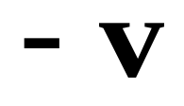
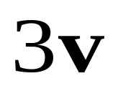
The negative of a vector is just a vector going the opposite way.
A number multiplied in front of a vector is called a scalar. It means to take the vector and add together that many times.

Slide 7




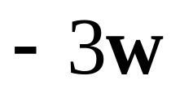



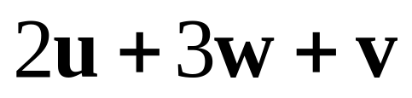
Using the vectors shown, find the following:

Slide 8
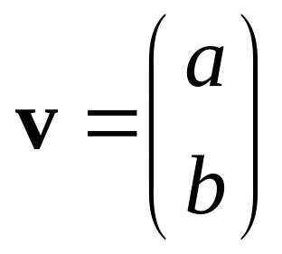
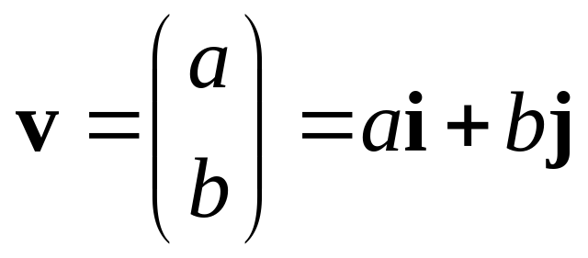


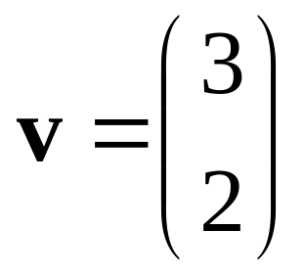
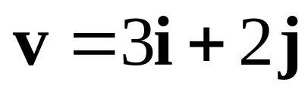
This is the notation for a position vector. This means the point (a, b) is the terminal point and the initial point is the origin.
Vectors are denoted with bold letters
We use vectors that are only 1 unit long to build position vectors. i is a vector 1 unit long in the x direction and j is a vector 1 unit long in the y direction.
(a, b)
(3, 2)

Slide 9
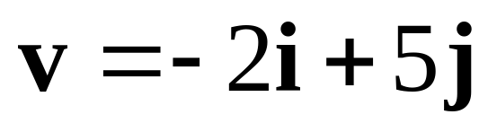
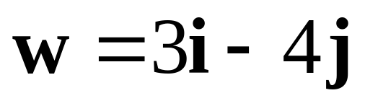
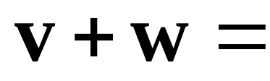
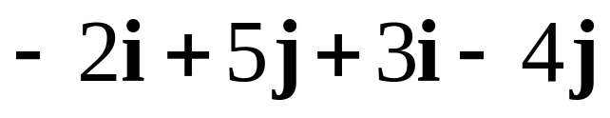
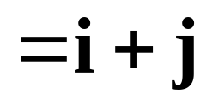

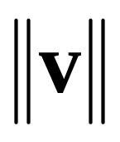
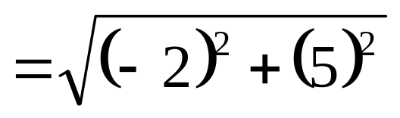



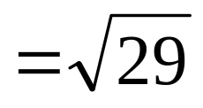


If we want to add vectors that are in the form ai + bj, we can just add the i components and then the j components.
When we want to know the magnitude of the vector (remember this is the length) we denote it
Let's look at this geometrically:
Can you see from this picture how to find the length of v?

Slide 10
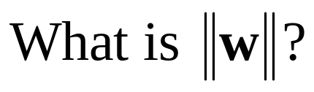
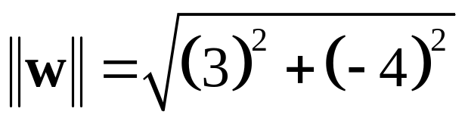
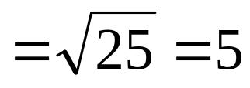
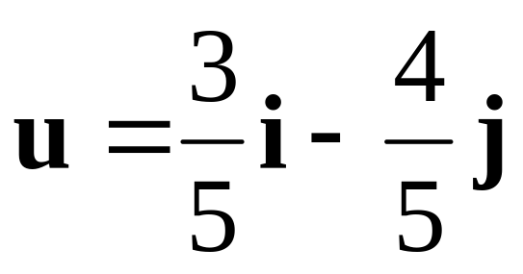
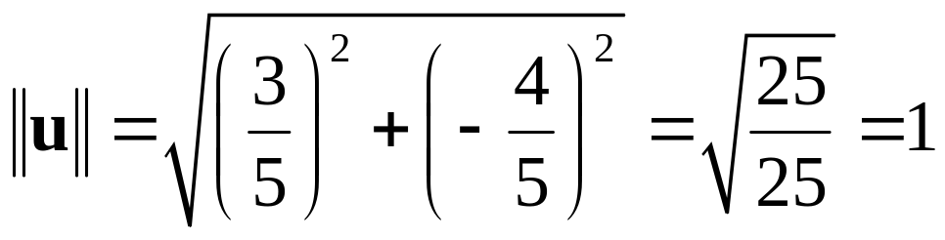
A unit vector is a vector with magnitude 1.
If we want to find the unit vector having the same direction as a given vector, we find the magnitude of the vector and divide the vector by that value.
If we want to find the unit vector having the same direction as w we need to divide w by 5.
Let's check this to see if it really is 1 unit long.

Slide 11
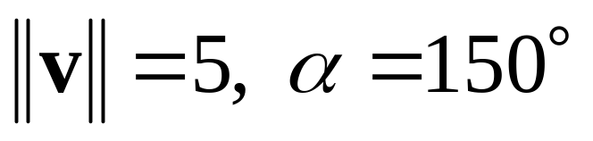


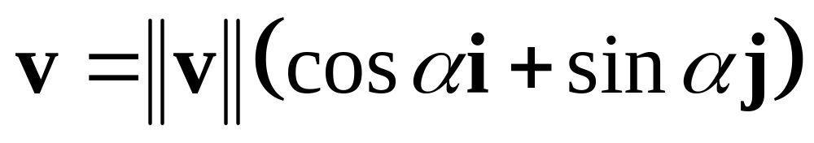
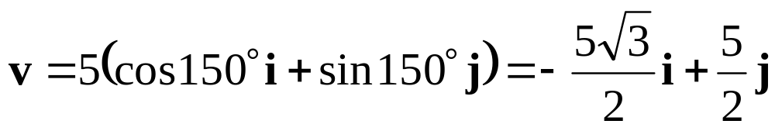
If we know the magnitude and direction of the vector, let's see if we can express the vector in ai + bj form.
As usual we can use the trig we know to find the length in the horizontal direction and in the vertical direction.

